Slide 1
Database Project: Lebanese Railways
Instructor: Mario Maroun
Done by: Hadi Dayeh, Mahmoud Farhat

Slide 2
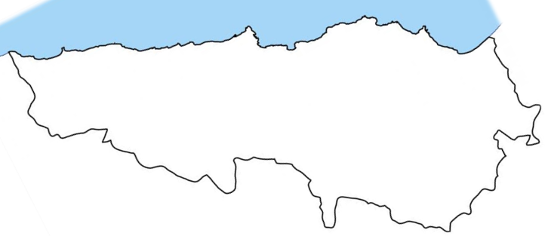
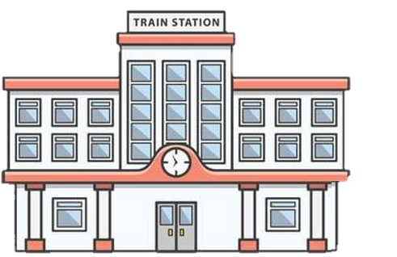
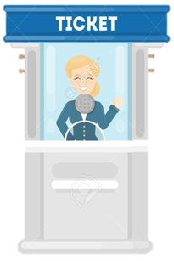









Sour
Beirut
Tripoli




Slide 3
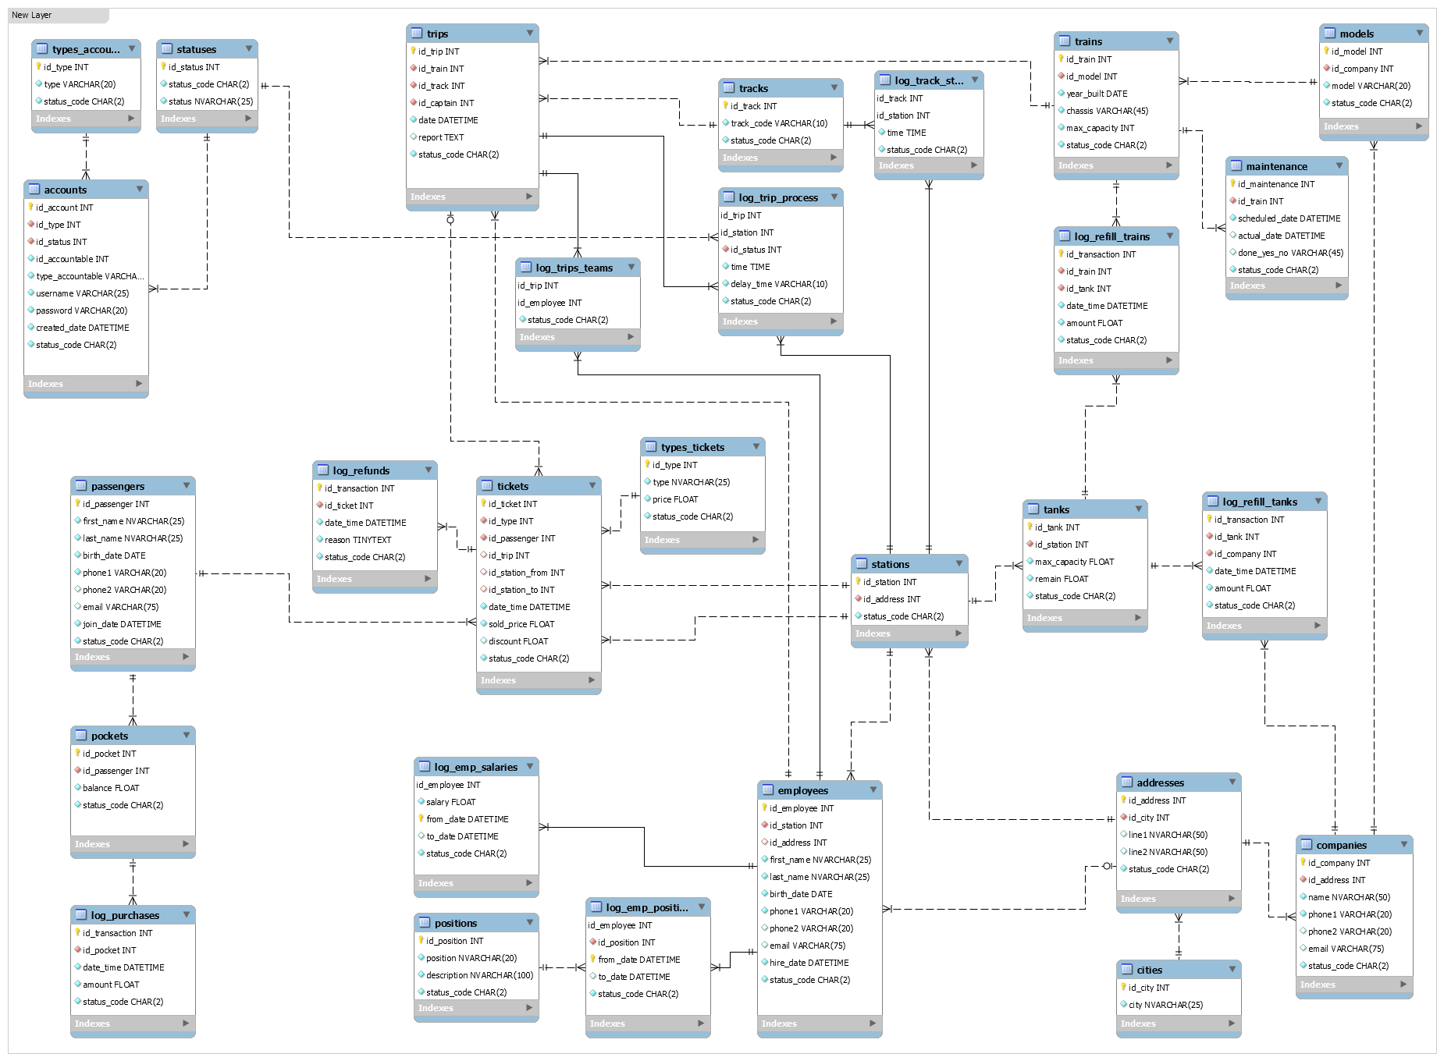

10- "trips" are run under a schedule.
09- A "passenger" joins "trips" from a station to another.
08- "Tickets" could be refunded for a reasons or another.
07- Each "purchase transaction" should be stored.
06- A "passenger" buys a ticket.
05- "Employees", "stations", and "companies", each has an "address".
04- Each "station" has many tanks, and each "tank" belongs to one station.
03- Each "train" has a "model" and is made by a company.
02- Each "ticket" has a "type" which could belong to another ticket too.
01- Each "passenger" has a "pocket".

Slide 4
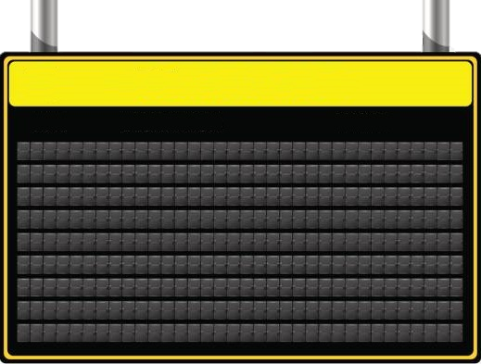
Schedule From Monday to Friday
Station Time
Sour 11:30 12:00 12:30 13:00 13:30 14:00 14:30 15:00 15:30 16:00 16:30
Beirut 12:00 12:30 13:00 13:30 14:00 14:30 15:00 15:30 16:00 16:30 17:00
Tripoli 12:30 13:00 13:30 14:00 14:30 15:00 15:30 16:00 16:30 17:00 17:30
Track 12 ..................................................................................................................................... Track 22
Sour 06:00 06:30 07:00 07:30 08:00 08:30 09:00 09:30 10:00 10:30 11:00
Beirut 06:30 07:00 07:30 08:00 08:30 09:00 09:30 10:00 10:30 11:00 11:30
Tripoli 07:00 07:30 08:00 08:30 09:00 09:30 10:00 10:30 11:00 11:30 12:00
Track 1 ....................................................................................................................................... Track 11

Slide 5
10- "trips" are run under a schedule.

Slide 6
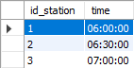
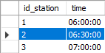
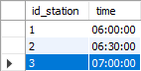
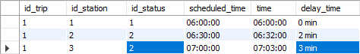
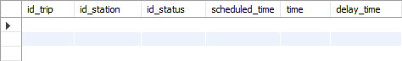
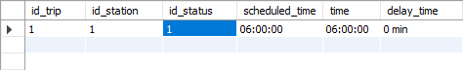
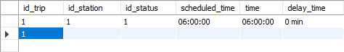
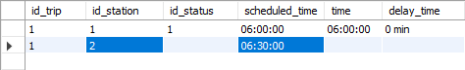
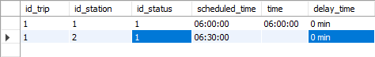
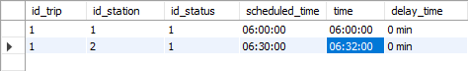
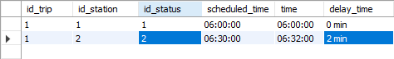
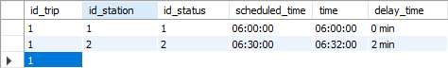
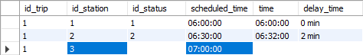
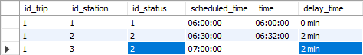
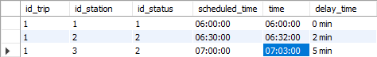
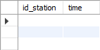
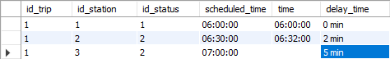
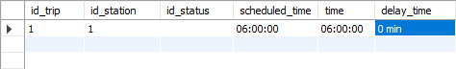
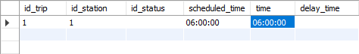
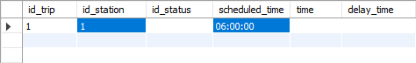
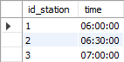
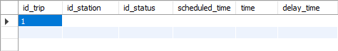
Scheduled time: 6:00
Scheduled time: 6:30
Scheduled time: 7:00
Sour
Beirut
Tripoli
Real time: 6:00
Real time: 6:32
Real time: 7:03
INSERT INTO trip_process (time)
VALUES (LOCALTIME);
Try to get next record from the view and set:
x = view.id_station;
y = view.time;
Try to get next record from the view and set:
x = view.id_station;
y = view.time;
SELECT log_track_stations.id_station, log_track_stations.time
FROM log_track_stations, trips
WHERE trips.id_trip = 1
AND log_track_stations.id_track = trips.id_track;
INSERT INTO trip_process (id_trip)
VALUES (“1”);
Try to get first record from the view and set:
x = view.id_station;
y = view.time;
INSERT INTO trip_process (id_station, scheduled_time)
VALUES (x, y);
Copy the (id_status) and the (delay_time) values into v1 and v2 then:
INSERT INTO trip_process (id_status, delay_time)
VALUES (v1, v2);
Go to next row then:
INSERT INTO trip_process (id_trip)
VALUES (“1”);
Calculate (d) the delay time, then: If (d = 0) {
UPDATE trip_process
SET delay_time = d, id_status = “1”
WHERE id_trip = “1” AND id_station = “3”; }
Calculate (d) the delay time, then: If (d = 0) {
INSERT INTO trip_process (delay_time, id_status)
VALUES (d, “1”);
}
Calculate (d) the delay time, then: else {
INSERT INTO trip_process (delay_time, id_status)
VALUES (d, “2”);
}
Calculate (d) the delay time, then: If (d = 0) {
UPDATE trip_process
SET delay_time = d, id_status = “1”
WHERE id_trip = “1” AND id_station = “2”; }
Calculate (d) the delay time, then: else {
UPDATE trip_process
SET delay_time = d, id_status = “2”
WHERE id_trip = “1” AND id_station = “2”; }
Calculate (d) the delay time, then: else {
UPDATE trip_process
SET delay_time = d, id_status = “2”
WHERE id_trip = “1” AND id_station = “3”; }
UPDATE trip_process
SET delay_time = “5 min”, id_status = “2”
WHERE id_trip = “1” AND id_station = “3”; }
1: Sour
2: Beirut
3: Tripoli
1: On Time
2: Delayed

Slide 7
Departures (Beirut)
Trip Number Destination Departure Time Status
1 Tripoli 06:30 AM Delayed (5 Minutes)
2 Sour 06:30 AM On Time
3 Tripoli 07:00 AM On Time
4 Sour 07:00 AM Canceled
5 Tripoli 07:30 AM On Time
6 Sour 07:30 AM On Time
7 Tripoli 08:00 AM Delayed (10 Minutes)
8 Sour 08:00 AM On Time

Slide 8
18- "Employees" and "passengers", each has an "account" on the system.
17- Each "employee" works at a station.
16- Each "employee" has a "position" and a salary that could change, but the change history should be saved.
15- The tanks are also refilled repeatedly by outside companies.
14- All "trains" are refilled with fuel several times per day, and each refill transaction should be saved.
13- All "trains" have to be checked up in a schedule.
12- Each "trip" is run by a team of "employees“, one of them is the captain, using a train.
11- A "trip" has a status. It could be on time, canceled, delayed, etc...
10- "trips" are run under a schedule.

Slide 9
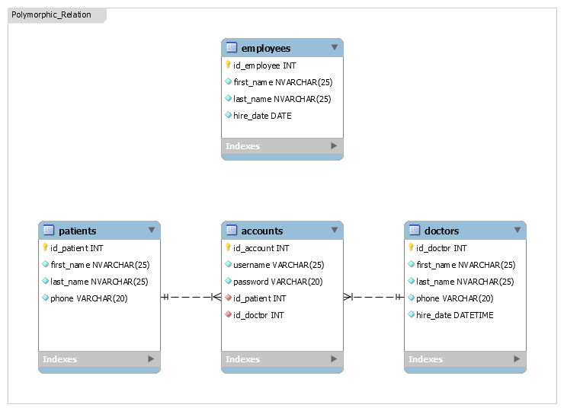
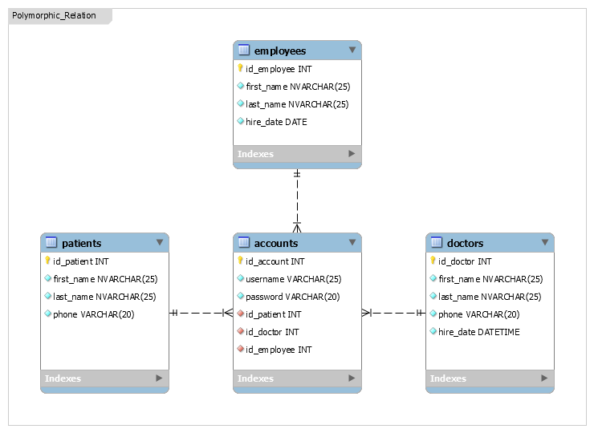
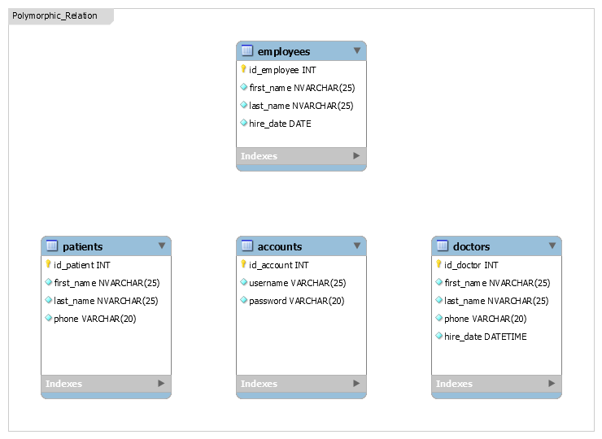

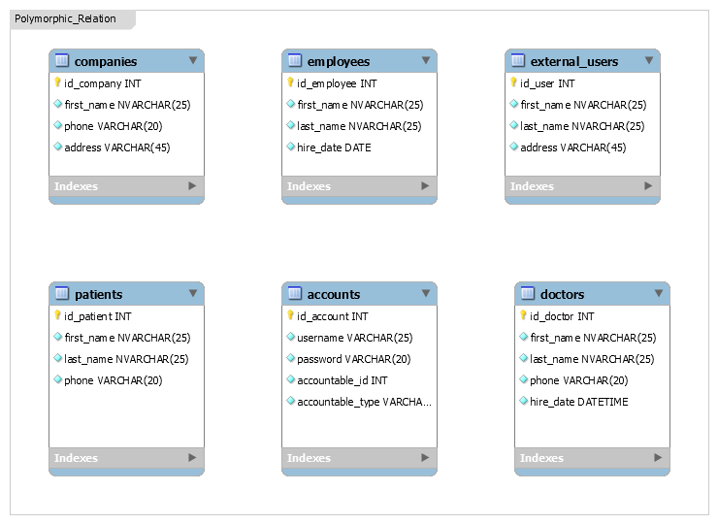

Polymorphic Relationship:
A polymorphic relationship is where an entity can belong to more than one other entity on a single association.

Slide 10
20- "Accounts" could be deactivated and reactivated.
18- "Employees" and "passengers", each has an "account" on the system.
19- Users could be a "external", "internal", "financial", "admin", etc...

Slide 11
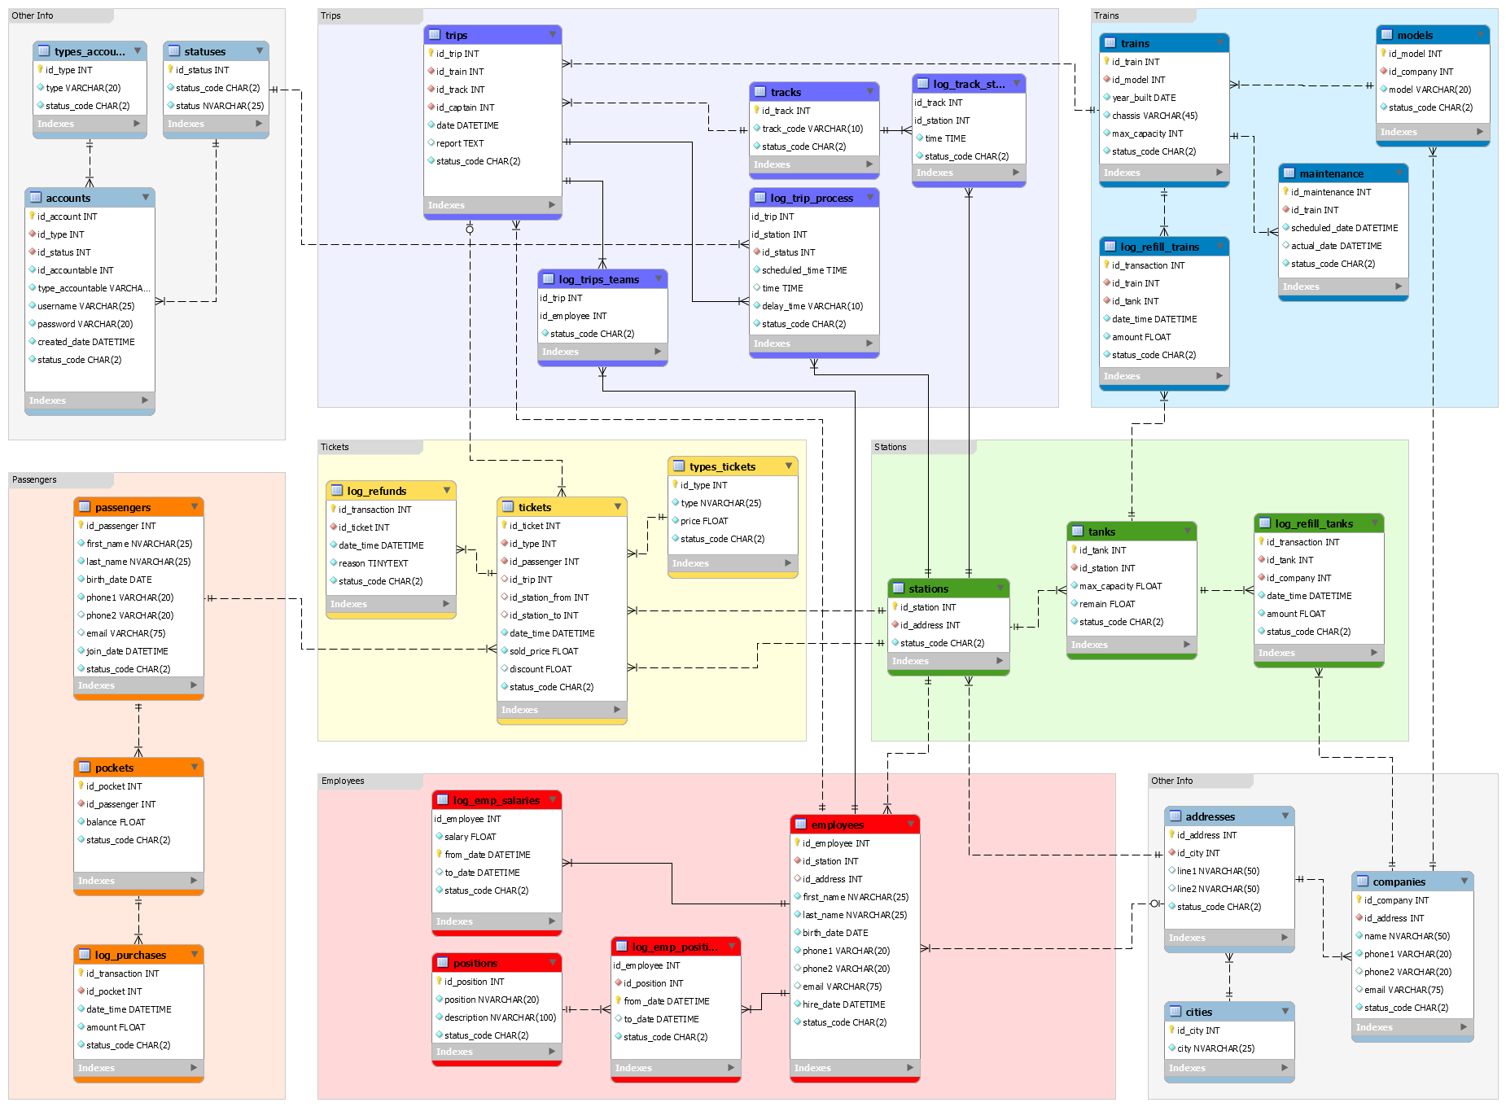

Slide 12
Why MySQL ??
It’s free (much cheaper than oracle).
Open source.
Cross platform compatibility.
Many of the world's largest and fastest-growing organizations including Facebook, Google, Adobe and Alcatel Lucent rely on MySQL to save time and money powering their high-volume Web sites, business-critical systems and packaged software.

Slide 13
What is MySQL ??
MySQL is an Oracle-backed open source relational database management system (RDBMS) based on Structured Query Language (SQL). MySQL runs on virtually all platforms, including Linux, UNIX and Windows. Although it can be used in a wide range of applications, MySQL is most often associated with web applications and online publishing.

Slide 14
